Slide 1





Cloud Computing

Slide 2









What is Cloud Computing?
Definition
Cloud computing delivers various IT resources as services over the internet, including compute, storage, networking, databases, and analytics - all available on-demand without direct hardware ownership.
Key Characteristics
Much like a public utility, you only pay for the IT resources you consume, rather than owning and maintaining your own physical infrastructure.
Resources include servers, storage, databases, networking, software, analytics, and intelligence
Pay-as-you-go pricing model eliminates large upfront capital expenditures
User
Cloud
IT Resources

Slide 3








Why We Need Cloud Computing
Cloud computing addresses traditional IT challenges by offering a modern, flexible, and efficient approach to technology resources.
Cost Efficiency
Scalability & Flexibility
Reliability
Shifts IT spending from CapEx to OpEx. Pay-as-you-go model eliminates large upfront costs for hardware and infrastructure.
Rapidly scale resources up or down to meet fluctuating demands, ensuring optimal performance during peak periods.
Globally distributed data centers with redundant infrastructure ensure high availability and consistent performance.
Simplified Management
Global Accessibility
Faster innovation
Offloads routine operational tasks to cloud providers, allowing IT teams to focus on strategic initiatives.
Enable employees to access applications and data from anywhere, facilitating remote work and global collaboration.
Spin up new services in seconds and easily test new ideas without hardware limitations

Slide 4


Slide 5




Question 1
Question 1: Which of the following best defines cloud computing?
A
Storing data on local servers
B
On-demand delivery of IT resources over the internet with pay-as-you-go pricing
C
Building physical data centers
D
Installing software on individual computers

Slide 6





Correct Answer: B
B) On-demand delivery of IT resources over the internet with pay-as-you-go pricing
Explanation:
Cloud computing delivers IT resources over the internet on an as-needed basis
Users pay only for what they consume, with no upfront capital expenditure
Contrast with traditional on-premises IT where organizations must purchase and maintain physical infrastructure
Key difference: Cloud computing is pay-as-you-go while traditional IT is typically upfront payment for resources

Slide 7


Question 2
Question 2: What is a key characteristic of cloud computing?
A
Fixed resource allocation
B
Local network access only
C
Rapid elasticity
D
Upfront payment for resources

Slide 8


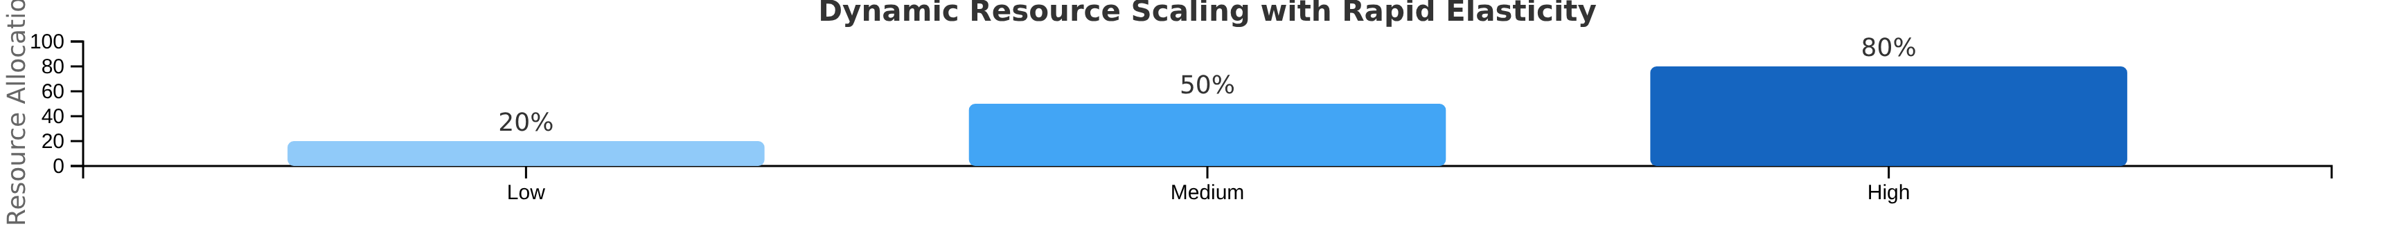




Correct Answer: C
Rapid elasticity is a core characteristic of cloud computing, enabling resources to be scaled up or down quickly and automatically to meet fluctuating demand.
Dynamic Allocation
Cost Efficiency
Resources adjust automatically to match workload demands, ensuring optimal performance.
Pay only for resources actually used, avoiding over-provisioning costs.

Slide 9






Question 3
Question 3
What does the 'pay-as-you-go' pricing model mean in cloud computing?
A
Paying a fixed monthly fee regardless of usage
B
Paying only for the resources actually used
C
Pre-paying for resources for a discount
D
Paying nothing until resources reach a certain threshold

Slide 10







Correct Answer: B
Traditional IT Model
The 'pay-as-you-go' pricing model in cloud computing means that users are billed only for the specific amount of computing resources they consume.
Upfront costs for all resources
Benefits of Pay-As-You-Go:
Optimizes costs by avoiding upfront capital expenditures
Cloud Pay-As-You-Go
Pay only for what you use
Prevents over-provisioning of resources
Provides flexibility to scale resources based on demand
This model allows organizations to match their resource spending with actual business needs.

Slide 11
















Stay Connected with Our Cloud Computing Journey!
Dive deeper into the cloud world! Check out our specialized playlists for your continuous learning journey!
Like this video if you found it helpful!
Subscribe for cloud tech updates!
Comment below which cloud topic you want to see next like:
Cloud Security Tips
Cost Optimization Strategies
Multi-Cloud Management
Serverless Computing
Cloud Migration Steps
Anything you'd like 🙂

Slide 12



Cloud Computing Benefits
Cloud Computing

Slide 13













Cloud Computing Benefits
Cloud computing offers significant advantages that transform business operations and strategic capabilities:
Cost Efficiency
Scalability & Flexibility
Shift from Capital Expenditure (CapEx) to Operational Expenditure (OpEx), paying only for resources consumed.
Rapidly scale resources up or down based on demand, ensuring optimal performance during peak loads.
Accelerated Innovation
Operational Efficiency
Access cutting-edge technologies without extensive in-house development, accelerating time to market.
Offload infrastructure management to providers, freeing internal IT to focus on strategic initiatives.
Business Continuity
Enhanced Security
Cloud providers design their infrastructure with high availability, redundancy, and disaster recovery capabilities. This ensures that data and applications remain accessible even in the event of localized outages, enhancing business resilience.
Cloud providers invest heavily in advanced security measures, including robust physical security, data encryption, access controls, and continuous monitoring.

Slide 14


Slide 15













Question 1
Question 1: Which benefit of cloud computing allows businesses to quickly access new technologies?
A
Cost savings
B
Agility
C
Security
D
Control

Slide 16





Correct Answer: B
Agility is a significant benefit of cloud computing
Allowing businesses to innovate faster and deploy new services by providing easy access to a broad range of technologies.
Key Benefits of Agility
Business Impact
Eliminates lengthy procurement processes
Responds rapidly to market changes
Reduces setup time for new services
Enhances customer satisfaction through faster feature delivery
Provides rapid access to testing environments
Supports experimental approaches with minimal risk
Key Insight: Cloud agility enables organizations to transition from idea to implementation in a matter of hours rather than months.

Slide 17



Question 2
Question 2: What characteristic of cloud computing allows for automatic scaling of resources?
A
Resource pooling
B
Measured service
C
Rapid Elasticity
D
Broad network access

Slide 18


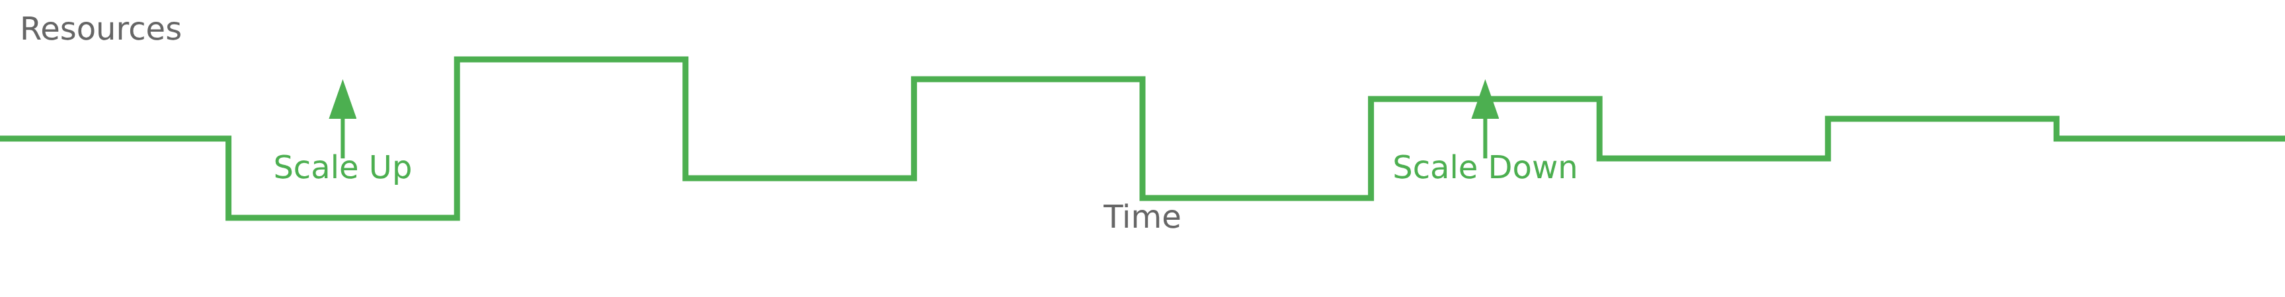

Correct Answer: C
Which characteristic of cloud computing allows for automatic scaling of resources?
C
Rapid elasticity - the characteristic that enables cloud systems to automatically provision and de-provision computing resources to match workload demands
Rapid elasticity ensures that:
Applications have necessary resources during peak times
Contributes to optimal performance
Enhances cost-efficiency
Unused resources are released during low periods

Slide 19

Cloud vs On-Premises: Key Differences
Understanding the fundamental distinctions between cloud and traditional IT infrastructure
vs
Cloud Computing
On-Premises

Slide 20







On-Premises IT Resources
Traditional infrastructure where organizations own and manage all components within their facilities.
Key Characteristics:
Physical Servers
Storage Devices
Physical servers, storage, and networking equipment located on-site
Dedicated processors for running applications
HDD, SSD, SAN, NAS for data persistence
Complete control over all infrastructure components
Requires dedicated data center space with power and cooling
Full responsibility for maintenance and updates
Networking Gear
Data Centers
Routers, switches, firewalls for connectivity
Physical facilities with power and cooling
Organizations bear full responsibility for all aspects of management

Slide 21











Cloud Computing IT Resources
On-demand IT resources delivered over the internet as services, where providers own and manage the infrastructure.
Key Features:
Pay-as-you-go pricing based on actual usage
Resources accessed remotely over the internet
Providers handle maintenance and updates
IaaS
PaaS
SaaS
Pay only for resources actually consumed
Virtual servers, storage, networking
Development platform, databases
Applications, email, CRM
Cloud computing follows a shared responsibility model where providers secure the cloud infrastructure, while users secure their data and applications.
Resources are rented and managed by a provider

Slide 22






Key Differences: Cost & Scalability
On-Premises
Cloud Computing
High Upfront Costs
Pay-As-You-Go Pricing
Significant capital expenditure (CapEx)
Operational expenditure (OpEx) instead of CapEx
Purchase of hardware, software, and licenses
VS
Pay only for resources consumed
Infrastructure setup and deployment costs
Costs align with actual usage
Limited Scalability
Instant Scalability
Fixed resource capacities
Rapidly scale resources up or down in minutes
Time-consuming hardware procurement
Automatic adjustment to fluctuating demands
Expanding capacity is slower and more expensive
No hardware procurement delays
Cost efficiency and scalability are key drivers for cloud adoption

Slide 23








Key Differences: Management & Innovation
On-Premises
Cloud Computing
In-House IT Staff
Rapid Deployment
Dedicated staff for management and updates
Easy access to cutting-edge technologies
Lengthy Deployment
Global Accessibility
Slow adoption of new technologies
Access from anywhere, at any time
Maintenance Burden
Faster Innovation
Requires continuous management
Focus on innovation rather than infrastructure
Key Insight: Cloud computing enables organizations to focus on innovation while offloading infrastructure management to providers.

Slide 25









Question 1
Which of the following best describes the primary financial model for an on-premises infrastructure?
A
Subscription-based model
B
Large upfront investment
Monthly fees (OpEx)
Hardware, licenses, and data center costs (CapEx)
C
Pay-as-you-go model
D
No initial cost model
Based on resource consumption
Fees based on data transfer

Slide 26











Answer 1: Cost Structure
Correct Answer: B) A large upfront capital investment in hardware and licenses (CapEx)
On-premises infrastructure necessitates a significant initial outlay, categorized as Capital Expenditure (CapEx). This includes the direct purchase of physical servers, networking equipment, storage devices, and software licenses, along with the costs associated with data center facilities such as space, power, and cooling.
On-Premises (CapEx)
Cloud (OpEx)
Large upfront hardware purchases
Subscription-based monthly fees
Software licenses as direct costs
Pay-as-you-go based on usage
Data center facility costs
Converts fixed costs to variable costs

Slide 27






Question 2
An e-commerce company expects a massive, temporary surge in traffic for a holiday sale. Which environment offers the most efficient way to handle this spike?
A
On-premises
B
Cloud
Pre-purchasing hardware for peak load
Rapid provisioning of resources on demand
C
On-premises
D
Both equally efficient
Manual installation during the sale
For handling traffic spikes

Slide 28









Answer 2
The correct answer is:
B) Cloud, by rapidly provisioning additional resources on demand and scaling down afterward
Why Cloud Wins for Scalability:
Unparalleled Elasticity: Cloud platforms can scale resources up or down in response to fluctuating demand.
Instant Provisioning: Additional servers, storage, and bandwidth can be provisioned almost instantly during peak demand.
On-premises
Cloud
Fixed capacity
Elastic scaling
Cost Efficiency: Resources can be scaled back down after peak demand, ensuring you only pay for what is used.
Holiday Sale Traffic
Instant Scaling
On-premises Limitation: Requires significant upfront investment in hardware to accommodate potential peak loads, leading to underutilized resources during off-peak times.
Normal
Peak
Post-Peak

Slide 29
Stay Connected with Our Cloud Computing Journey!
Dive deeper into the cloud world! Check out our specialized playlists for your continuous learning journey!
Like this video if you found it helpful!
Subscribe for cloud tech updates!
Comment below which cloud topic you want to see next like:
Cloud Security Tips
Cost Optimization Strategies
Multi-Cloud Management
Serverless Computing
Cloud Migration Steps
Anything you'd like 🙂

Slide 30


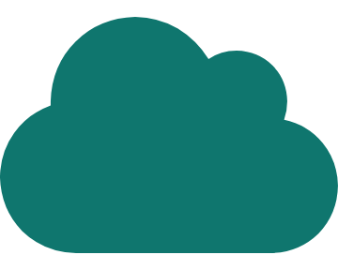

Leading Cloud Service Providers
Global Cloud Market Overview
Global Perspective
Future Trends

Slide 31









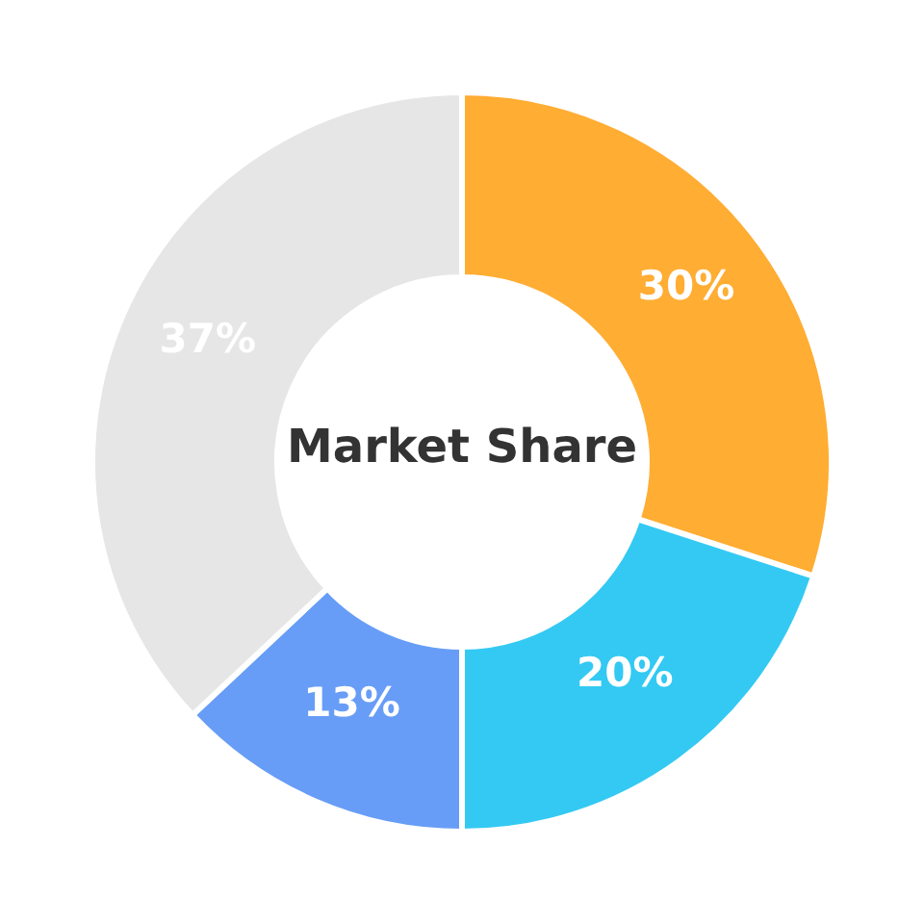







The "Big Three" Cloud Providers
Amazon Web Services
Microsoft Azure
Google Cloud
Market Share:
23%
Market Share:
13%
Market Share:
29%
Quarterly Revenue:
Quarterly Revenue:
Quarterly Revenue:
$29.9B
$13.6B
$30.9B
Key Strengths:
Key Strengths:
Key Strengths:
Enterprise integration & Microsoft ecosystem
AI/ML leadership & advanced analytics
Broadest service range (200+ services)
Robust hybrid cloud capabilities
Strong open-source support (Kubernetes)
Global reach (36 regions, 114 availability zones)
Strong PaaS/SaaS focus
Competitive pricing & global network
Mature ecosystem & reliability
AWS (30%)
Azure (20%)
GCP (13%)

Slide 32







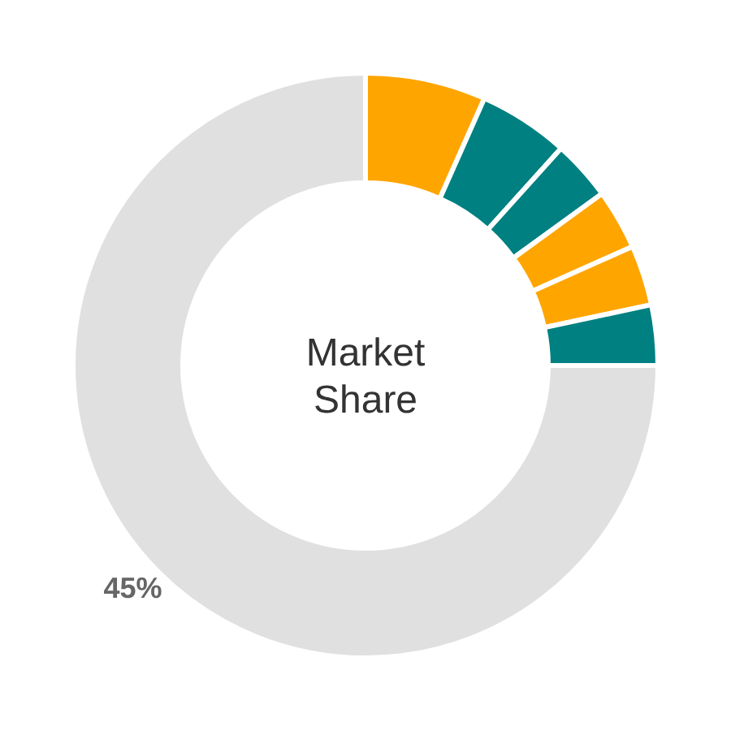










Other Significant Players
Market Share
Alibaba Cloud
Oracle Cloud
4% Market Share
3% Market Share
Specialization: Elastic computing services, localized support
Specialization: Data management, databases, custom applications
Region: Strong in Asia-Pacific, especially Southeast Asia
Unique: Consistent global pricing and hybrid cloud solutions
IBM Cloud
Tencent Cloud
2% Market Share
2% Market Share
Specialization: Hybrid and multi-cloud deployments
Specialization: Gaming, media, and entertainment offerings
Integration: Strong with legacy systems and Red Hat OpenShift
Region: Strong in China and Southeast Asia
Salesforce
Huawei
2% Market Share
2% Market Share
Specialization: Cloud-based applications for CRM, marketing
Specialization: ICT infrastructure, cloud services
Region: Strong in China and emerging markets
These providers hold the remaining market share after the "Big Three"
Pioneering: Leader in the Software-as-a-Service (SaaS) model

Slide 33








Comparative Analysis & Future Trends
Amazon Web Services
Microsoft Azure
Google Cloud
Key Strengths
Key Strengths
Key Strengths
Broadest service range (over 200 services)
Enterprise integration with Microsoft ecosystem
AI/ML leadership with advanced Vertex AI and TensorFlow
Global reach (36 regions, 114 availability zones)
Hybrid cloud capabilities (Azure Arc, Azure Stack)
Data analytics power with BigQuery and Dataflow
Mature ecosystem with strong reliability
"The pioneer and market leader in cloud computing"
Strong PaaS/SaaS focus with enterprise-grade services
Open-source focus with strong Kubernetes support
"Second-largest market share with robust enterprise integration"
"Distinguished by advanced capabilities in AI, ML, and data analytics"

Slide 34
Stay Connected with Our Cloud Computing Journey!
Dive deeper into the cloud world! Check out our specialized playlists for your continuous learning journey!
Like this video if you found it helpful!
Subscribe for cloud tech updates!
Comment below which cloud topic you want to see next like:
Cloud Security Tips
Cost Optimization Strategies
Multi-Cloud Management
Serverless Computing
Cloud Migration Steps
Anything you'd like 🙂

Slide 35
















Cloud Deployment Models
Understanding Public, Private, Hybrid, and Community Clouds
Public Cloud
Private Cloud
Hybrid Cloud
Community Cloud

Slide 36














What Are Deployment Models?
Cloud deployment models define the specific type of cloud environment based on its ownership, scale, and access.
The Four Core Models
These models are crucial for organizations to align their IT strategy with business objectives, considering factors like security, control, cost, and scalability.
Public Cloud
Private Cloud
Services offered over the internet by third-party providers
Dedicated infrastructure for a single organization
Key Considerations:
Community Cloud
Hybrid Cloud
Shared infrastructure for organizations with common concerns
Who manages the underlying infrastructure?
Combination of public and private environments
How are resources provisioned and consumed?
What level of security and control is required?
How will the environment be accessed?

Slide 37




















Public Cloud
Key Characteristics
Public Cloud makes IT infrastructure and services available to the general public over the internet, with a third-party cloud service provider (CSP) owning and managing the underlying infrastructure.
Multi-tenancy
Internet Accessibility
Multiple customers share the same physical infrastructure, with logical separation of resources and data
Services are delivered over the internet, accessible from anywhere with a connection
How Public Cloud Works
In the Public Cloud model, resources are shared among multiple customers (multi-tenancy), with logical separation of resources and data. The CSP is responsible for all infrastructure management, maintenance, security, and updates.
Provider Management
Pay-as-you-go Model
The CSP is responsible for all infrastructure management, maintenance, security, and updates
Customers pay only for the resources they consume, typically on a subscription or usage-based model
User
CSP
Resources

Slide 38

















Private Cloud
A private cloud is a cloud computing environment where all resources are isolated and operated exclusively for a single organization, combining cloud benefits with the security and control of on-premises IT.
Private Cloud Architecture
Enhanced Security
Regulatory Compliance
Key Characteristics
Significant layers of security including firewalls, VPNs, encryption, and IAM
Can be tailored to meet specific compliance requirements (GDPR, HIPAA, PCI DSS)
Exclusivity
Resources are dedicated solely to one organization, ensuring no sharing with other tenants
Isolation
Greater Control
Improved Performance
The environment is protected by private firewalls, offering a heightened layer of security
Complete command over service integration, IT operations, and customization
Isolating workloads on dedicated servers eliminates "noisy neighbor" issues
Control
The organization has full control over hardware, software, security features, and infrastructure management
Deployment Flexibility
Can be hosted in-house (on-premises), in an off-site data center, or within a public cloud service provider's infrastructure

Slide 39



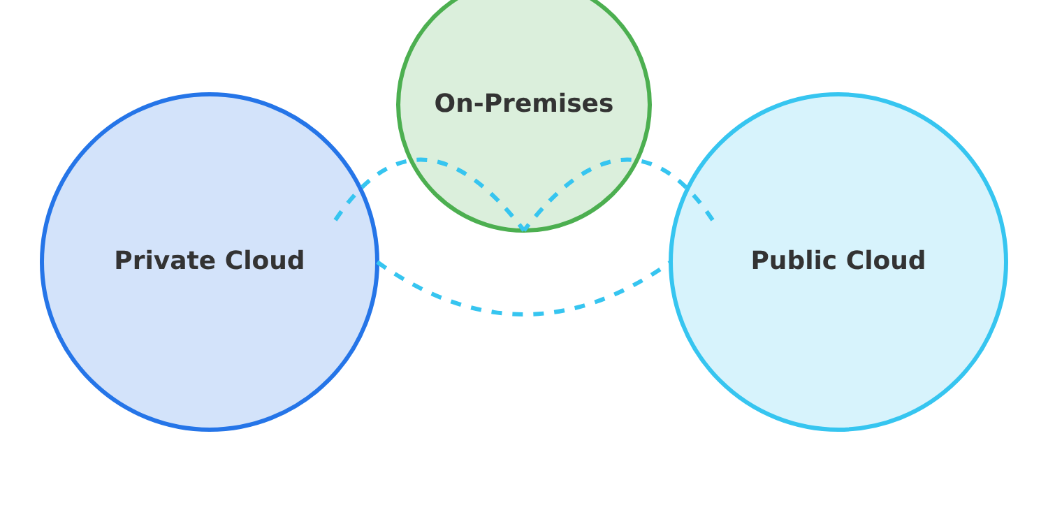





Hybrid Cloud
Hybrid Cloud integrates two or more distinct cloud infrastructures (public, private, or on-premises) into a single, flexible, and unified environment.
Hybrid Cloud Architecture
Architecture & Integration Approaches
Combined Infrastructure
Typically involves at least one private cloud and one public cloud, potentially including multiple private and public clouds
Interconnection
Secure network connections (e.g., VPNs, dedicated connections) facilitate communication and data transfer
Workload Portability
Private Cloud
Public Cloud
On-Premises
Applications and data can be moved between public and private clouds, often orchestrated using technologies like containers

Slide 40























Community Cloud
Community Cloud is cloud infrastructure shared among several organizations that have common concerns, such as regulatory requirements, security needs, or compliance standards.
Community Cloud Structure
Key Characteristics:
Shared Ownership/Management: Infrastructure owned by one or more participating organizations, a third-party provider, or a combination
Industry Use Cases:
Specific Community: Access limited to members of a defined community (e.g., government agencies, healthcare providers)
Government
Healthcare
Multiple governmental departments share infrastructure for processing systems
Healthcare providers securely share patient data and collaborate on research
Tailored Environment: Configured to meet collective requirements of the community
Cost Sharing: Infrastructure, maintenance, and management costs distributed among participating members
Financial Services
Academic & Research
Financial institutions leverage clouds for secure transactions and fraud detection
Educational institutions share computational resources for simulations and analysis

Slide 41


















Deployment Models Comparison
Feature
Private Cloud
Public Cloud
Hybrid Cloud
Community Cloud
Ownership/Users
Exclusive to a single organization
Shared by multiple, unrelated organizations
Combination of private/on-premises and public clouds
Shared by a specific group of organizations with common concerns
Security
Highest level, fully customizable
Provider-managed, generally robust but shared
High for sensitive data, flexible for others
High, tailored to community's specific needs
Scalability
Limited, requires hardware investment
Highly scalable, on-demand
Highly scalable (leverages public cloud)
Limited, depends on community's shared resources
Cost Structure
High initial CAPEX, predictable OPEX
Low initial CAPEX, pay-as-you-go OPEX (variable)
Balanced CAPEX/OPEX, optimized spending
Shared CAPEX/OPEX among members
Control
Full control over infrastructure
Limited control over underlying infrastructure
Significant control over private components, less over public
Shared control among community members

Slide 43
















Question 1
Which deployment model offers a cloud environment for the exclusive use of a single organization?
A
Public Cloud
B
Private Cloud
C
Hybrid Cloud
D
Multi-Cloud

Slide 44










Answer 1
Correct Answer: B. Private Cloud
A Private Cloud provides dedicated infrastructure owned and operated by a single organization for its exclusive use.
Enhanced Security
Greater Control
Customization
Full control over security measures and compliance requirements.
Complete oversight of cloud resources and operations.
Tailor the environment to meet specific organizational needs.
Did you know?
Private clouds can be hosted on-premises or by third-party providers, as long as the infrastructure is dedicated to a single organization.

Slide 45











Question 2
Which deployment model combines on-premises infrastructure with public cloud resources?
On-premises
Private Cloud
Public Cloud
A
Public Cloud
B
Private Cloud
C
Hybrid Cloud
D
Community Cloud

Slide 46












Answer 2
A Hybrid Cloud combines private cloud, public cloud, and on-premises resources to create a flexible, unified environment.
Private Cloud
Public Cloud
Dedicated resources
On-premises
Scalable resources
Traditional infrastructure
Flexible Architecture
Resource Optimization
Combines multiple deployment models for optimal resource utilization
Store sensitive data in private cloud while deploying customer apps in public cloud

Slide 47












Question 3
Which deployment model is most cost-effective for startups with no existing infrastructure?
A
Public Cloud
B
Private Cloud
Pay-as-you-go model with no upfront infrastructure investment
Dedicated infrastructure but requires significant upfront investment
C
Hybrid Cloud
D
On-premises
Combination of private and public, but more complex to manage
Traditional data center with highest upfront costs

Slide 48








Answer 3
Correct Answer: Public Cloud
Why is Public Cloud the most cost-effective for startups?
Public Cloud eliminates upfront investment in hardware and infrastructure, offering pay-as-you-go pricing that scales with business needs.
No Upfront Investment
Rapid Scaling
Accessibility
Eliminates hardware and data center infrastructure costs
Scale resources up or down based on demand
Access resources from anywhere with internet connection
Did you know?
Startups can reduce costs by up to 40% by using Public Cloud services instead of on-premises infrastructure.

Slide 49
Stay Connected with Our Cloud Computing Journey!
Like this video if you found it helpful!
Subscribe for cloud tech updates!
Comment below which cloud topic you want to see next like:
Cloud Security Tips
Cost Optimization Strategies
Multi-Cloud Management
Serverless Computing
Cloud Migration Steps
Anything you'd like 🙂
Dive deeper into the cloud world! Check out our specialized playlists for your continuous learning journey!

Slide 50





IaaS, PaaS, SaaS Explained
Cloud Computing Service Models Simplified
Infrastructure as a Service (IaaS)
Platform as a Service (PaaS)
Software as a Service (SaaS)

Slide 51











Introduction to Cloud Service Models
Revolutionizing IT Resource Management
The Three Primary Service Models
Cloud computing has transformed how organizations acquire, manage, and utilize IT resources, offering unprecedented flexibility, scalability, and cost-efficiency.
Infrastructure as a Service (IaaS)
Virtualized computing resources over the internet
Key Benefits of Cloud Computing
Platform as a Service (PaaS)
Development platform with tools and services
Pay-as-you-go pricing eliminates large upfront capital expenditures
Resources can be provisioned or de-provisioned rapidly to meet changing demand
Software as a Service (SaaS)
Access to advanced technologies without extensive IT expertise
Complete software applications accessed via the web
Enhanced scalability and elasticity to support business growth

Slide 52















Infrastructure as a Service (IaaS)
Definition
IaaS provides:
Compute
Storage
Networking
Virtual machines, CPUs, GPUs, RAM
Block, file, object
Routers, switches, load balancers
Shared Responsibility Model
Provider
User
Key Advantages
Physical infrastructure
Operating systems
Pay-as-you-go pricing eliminates large upfront capital expenditures
Hardware
Applications
High flexibility and control over IT resources
Virtualization layer
Data
Scalability and elasticity to meet fluctuating demand

Slide 53


















Platform as a Service (PaaS)
Definition & Overview
What PaaS Provides
Platform as a Service (PaaS) is a cloud computing model that delivers a complete, on-demand cloud platform for developing, running, and managing applications.
Hardware Infrastructure
Servers, storage, networking components
Operating System
It provides hardware, software, infrastructure, operating systems, middleware, runtime environments, and development tools specifically designed for application development.
Managed operating systems and virtualization
Middleware
Runtime environments and application servers
Development Tools
IDEs, source control, testing tools, CI/CD
Key Abstraction
PaaS abstracts away the complexities of managing underlying infrastructure, allowing developers to focus solely on writing code and building applications.
Database Management
Managed databases and data storage
It significantly reduces the time and effort required to set up development environments and deploy applications.

Slide 54














Software as a Service (SaaS)
Definition
Well-Known SaaS Examples
Software as a Service (SaaS) is a cloud computing model that delivers complete, ready-to-use software applications over the internet, typically via a web browser or mobile app.
Email
CRM
Gmail, Outlook
Salesforce
How SaaS Works
Office
Video Conferencing
Microsoft 365
Zoom
Applications are hosted by the provider and accessed via the internet
Users access software on a subscription or pay-as-you-go basis
SaaS is Ideal For:
No installation or maintenance required on user end
End-users needing immediate access to software solutions
Provider handles all aspects of infrastructure and software management
Business departments requiring specific applications
Organizations seeking to reduce IT infrastructure costs
Remote and hybrid work environments

Slide 55


















Comparison: Shared Responsibility Model
Infrastructure as a Service
Platform as a Service
Software as a Service
User Manages
User Manages
User Manages
Operating systems, middleware, runtime, applications, data
Applications, data
User access, application configuration settings
Provider Manages
Provider Manages
Provider Manages
Networking, storage, servers, virtualization, OS, middleware, runtime
All of the above + applications, data
Networking, storage, servers, virtualization
Level of Control & Responsibility
Level of Control
Flexibility
Complexity for User
IaaS:
High
IaaS:
Most flexible
IaaS:
Highest
PaaS:
Medium
PaaS:
Moderate
PaaS:
Moderate
SaaS:
Low
SaaS:
Least flexible
SaaS:
Lowest

Slide 57







Question 1
Which service model delivers complete ready-to-use software product over the internet?
A
Infrastructure as a Service
B
Platform as a Service
C
Software as a Service
D
Function as a Service

Slide 58











Answer 1
The correct answer is C) SaaS
Software as a Service (SaaS) delivers a complete application over the internet, managed and maintained by the service provider.
Web Access
Provider Managed
Users access SaaS applications through a web browser without needing to install or manage any software.
The service provider handles all aspects of application management, including maintenance, updates, and security.
Examples
Salesforce
Microsoft Office 365

Slide 59




Question 2
Which cloud service model provides fundamental building blocks of computing, networking, and storage?
A
SaaS
B
PaaS
C
IaaS
D
FaaS

Slide 60










Answer 2
Correct Answer: C) IaaS
Infrastructure as a Service (IaaS) Definition:
IaaS provides virtualized computing resources over the internet, including virtual machines, storage, and networking. It's akin to renting the basic hardware components for your IT infrastructure.
A prime example of IaaS is AWS EC2 (Elastic Compute Cloud), where users can launch virtual machines without owning or managing the physical servers.
Virtual Machines
Storage
Networking
Elastic Compute Cloud (EC2) instances that can be provisioned on-demand
Scalable storage options including SSD and HDD volumes
Virtual networks, subnets, and load balancers

Slide 61






Question 3
Which service model supports the complete web application lifecycle: building, testing, deploying, managing, and updating?
Building
Testing
Deploying
Managing
A
IaaS
B
PaaS
C
SaaS
D
FaaS

Slide 62












Answer 3
Platform as a Service (PaaS) provides a complete development and deployment environment in the cloud, with resources that enable developers to build, test, deploy, run, and manage applications.
Users don't manage the underlying infrastructure (hardware, operating systems, network, or servers).
Build
Test
Deploy
Manage
Develop applications
Test applications
Deploy applications
Monitor & maintain
Key Benefits of PaaS:
Abstracts infrastructure management
Provides development tools & libraries
Enables rapid application deployment
Offers scalability & reliability

Slide 63












Question 4
Which of the following is an example of a PaaS offering?
A
AWS EC2
B
Salesforce
C
AWS Elastic Beanstalk
D
Microsoft Office 365

Slide 64











Answer 4
The correct answer is C) AWS Elastic Beanstalk
.
IaaS
PaaS
SaaS
Infrastructure as a Service - Provides virtual machines, storage, and networking
Platform as a Service - Provides development environment and deployment platform
Software as a Service - Provides complete applications to end users
Example: AWS EC2
Example: Google App Engine
Example: Salesforce
Did you know?
Google App Engine was launched in 2008 and was one of the first cloud services to offer a platform for web application development. It supports multiple programming languages including Python, Java, Node.js, Go, and PHP.

Slide 65
Stay Connected with Our Cloud Computing Journey!
Dive deeper into the cloud world! Check out our specialized playlists for your continuous learning journey!
Like this video if you found it helpful!
Subscribe for cloud tech updates!
Comment below which cloud topic you want to see next like:
Cloud Security Tips
Cost Optimization Strategies
Multi-Cloud Management
Serverless Computing
Cloud Migration Steps
Anything you'd like 🙂

Slide 66









Amazon Web Services (AWS)
The World's Most Comprehensive Cloud Computing Platform

Slide 67






What is AWS?
Global Infrastructure
38
120
700+
Over 200 fully featured services from data centers globally, enabling organizations to access scalable computing resources on demand.
Geographic Regions
Availability Zones
Edge Locations
Pay-as-you-go pricing model eliminates upfront capital expenses and the cost of idle resources.
Infrastructure as a Service (IaaS), Platform as a Service (PaaS), and various managed cloud services.

Slide 68
























Key Use Cases of AWS
AWS is leveraged across diverse industries for various applications, enabling organizations to innovate, scale, and optimize operations.
Media & Entertainment
Financial Services
Manufacturing
Netflix uses AWS for scalable streaming and content delivery using S3 and EC2.
Capital One use it for infrastructure purpose for banking applications.
Volkswagen & Siemens use AWS IoT and data analytics to optimize production and build industrial clouds.
Benefits: Seamless streaming, global scale
Benefits: Enhanced security & regulatory compliance
Benefits: Optimized operations, innovation speed
Retail & Ecommerce
Healthcare & Pharma
Technology & SaaS
Nordstrom uses AWS to provide a scalable, secure online shopping platform.
Pfizer and Johnson & Johnson use AWS to accelerate R&D and manage large datasets securely.
Salesforce, Airbnb, and Twitch deploy flexible, high-availability platforms with AWS compute and storage.
Benefits: Improved customer experience, scaling
Benefits: Faster innovation, secure data management
Benefits: Rapid growth, operational efficiency4

Slide 69



















AWS Service Categories: Compute & Storage
Compute Services
Storage Services
Amazon EC2
Amazon S3
Elastic Compute Cloud - Provides virtual servers (instances) in the cloud, offering scalable compute capacity for various workloads.
Simple Storage Service - Offers highly scalable, durable, and secure object storage for a wide range of use cases, including backup and archiving.
AWS Lambda
Amazon EBS
Serverless compute service that runs code in response to events, automatically managing the underlying compute resources.
Elastic Block Store - Provides persistent block storage volumes for use with Amazon EC2 instances, suitable for databases and high-performance applications.
Amazon ECS/EKS
Amazon EFS
Elastic Container Service/Elastic Kubernetes Service - Services for orchestrating and managing Docker containers at scale.
Elastic File System - A scalable, elastic file storage service for use with AWS Cloud services and on-premises resources.

Slide 70















AWS Service Categories: Databases & Networking
Database Services
Networking Services
Amazon RDS
Amazon VPC
Amazon CloudFront
Managed service for relational databases supporting MySQL, PostgreSQL, Oracle, and SQL Server. Easy setup, operation, and scaling.
Provision a logically isolated section of AWS Cloud where you can launch resources in a virtual network defined by you.
Fast content delivery network (CDN) service that securely delivers data, videos, applications, and APIs to customers globally with low latency.
Amazon DynamoDB
Fully managed, serverless NoSQL database with single-digit millisecond performance at any scale.
Amazon Route 53
Elastic Load Balancer
Highly available and scalable cloud Domain Name System (DNS) web service that routes traffic to the right resources.
Automatically distributes incoming application traffic across multiple targets, such as EC2 instances, in multiple Availability Zones.
Amazon Aurora
High-performance relational database compatible with MySQL and PostgreSQL, offering commercial-grade features at open-source prices.

Slide 72






Question 1
Which of the following best describes Amazon Web Services (AWS)?
A
A software company that develops operating systems for servers.
B
A global provider of on-demand cloud computing platforms and APIs.
C
A hardware manufacturer specializing in data center equipment.
D
A consulting firm focused on IT infrastructure planning.

Slide 73




Answer 1
Correct Answer: B
A global provider of on-demand cloud computing platforms and APIs.
Explanation:
AWS is a comprehensive, evolving cloud computing platform provided by Amazon. It offers a vast array of on-demand IT resources, including compute power, storage, databases, networking, analytics, machine learning, and more, all accessible over the internet with a pay-as-you-go pricing model.
This allows businesses to scale their infrastructure up or down as needed without significant upfront investment in hardware.
Did you know?
AWS provides over 200 fully featured services across multiple regions worldwide, allowing businesses to operate at global scale.

Slide 74











Question 2
Which of the following are common use cases for AWS services?
Hosting websites and web applications.
Performing big data analytics and machine learning.
Implementing backup and disaster recovery solutions.
All of the above.

Slide 75








Answer 2
Correct Answer: D
All of the above
AWS provides a wide range of services that cater to diverse use cases:
Website Hosting
Big Data Analytics
Disaster Recovery
Amazon EC2 and Amazon S3 are commonly used for hosting websites and web applications.
Services like Amazon EMR, Amazon Redshift, and Amazon SageMaker support big data analytics and machine learning.
AWS offers robust solutions through Amazon S3, Amazon Glacier, and AWS Backup for backup and disaster recovery.
Key Point: The versatility of AWS allows it to support all these critical functions and many more, making it a comprehensive cloud platform for businesses of all sizes.

Slide 76
Stay Connected with Our Cloud Computing Journey!
Dive deeper into the cloud world! Check out our specialized playlists for your continuous learning journey!
Like this video if you found it helpful!
Subscribe for cloud tech updates!
Comment below which cloud topic you want to see next like:
Cloud Security Tips
Cost Optimization Strategies
Multi-Cloud Management
Serverless Computing
Cloud Migration Steps
Anything you'd like 🙂

Slide 77








AWS
Offerings
Understanding of Free, Always Free, Paid, and Trial Plans
Free Plan
Always Free
Paid Plan
Short-Term Trial

Slide 78


















AWS Free Plan
The AWS Free Plan is designed for new customers to explore and experiment with AWS services without incurring costs or long-term commitments.
SIGN-UP
+
ADDITIONAL
$100
$100
Key Features
Up to $200 in credits ($100 sign-up + $100 additional)
6 months of free service usage
Free Plan Expiration Process
Free usage of select services and over 30 "Always Free" services
No charges initially (unless upgraded to Paid Plan)
Account Created
6 Months
Resources Retained (90 days)
Limitations
What Happens After Expiration?
Workloads cannot scale beyond credit thresholds
Account closes, but resources/data retained for 90 days
Limited access to select AWS services
Upgrade to Paid Plan to restore access to resources
Expires after 6 months or when credits are exhausted
Credits expire after 12 months from account creation

Slide 79























AWS Always Free Services
AWS Always Free offers perpetually free service offerings with specified monthly limits that never expire.
Perpetual
Monthly Reset
Cost Savings
Free usage limits do not expire, unlike the Free Plan or short-term trials
Free usage limits are automatically reset and available every month
Free tier credits automatically applied to any usage that exceeds limits
AWS Lambda
Amazon S3
Amazon DynamoDB
AWS CodeBuild
1M requests/month
5 GB storage
25 GB storage
100 build minutes/month
Execute code without provisioning servers
Scalable storage for any data
NoSQL database with reserved capacity
Automated build service

Slide 80

















AWS Paid Plans
Pricing Models
AWS Paid Plans provide full access to over 200 AWS services with flexible pricing options to optimize your costs based on your usage patterns and commitment level.
Pay-as-you-go
Savings Plans
Default model with no long-term contracts
Commit to usage amount for 1-3 years
-72%
Key Benefits
Pay per hour/second
Up to 72% off
Unrestricted access to all 200+ AWS services
Scalability beyond Free Tier limitations
Reserved Instances
Volume-based Discounts
Eligibility for various cost-saving plans
Commit to specific instance types
Up to 75% off
Lower prices for higher usage volumes
-75%
Economies of scale
Spot Instances
Dedicated Hosts
Bid for unused capacity
Physical servers for exclusive use
-90%
Up to 90% off On-Demand
Higher cost

Slide 81




















AWS Short-Term Trials
Short-Term Trials provide limited-time free access to specific AWS services, enabling users to evaluate them before making a commitment to paid usage.
Short-Term Trial Process
Trial Begins
Trial Period
Post-Trial
Key Features
Free access to specific AWS services for a limited time (typically 30 days)
How Trials Work
Available for particular services only, distinct from Free Plan or Always Free
1
Trial commences when user first begins utilizing the eligible service
Access until trial period expires or usage threshold is reached
2
Service remains free until the trial period expires or usage limit is reached
Focus on specific services for a defined period or usage threshold
3
Upon expiration, standard pay-as-you-go rates apply with any eligible Free Tier credits applied
After Trial Ends
Standard pay-as-you-go rates applied for any subsequent use
Eligible Free Tier credits automatically applied to cover charges
Trial Example
Option to upgrade to a paid plan to continue using the service
Amazon QuickSight
Redshift

Slide 82
Stay Connected with Our Cloud Computing Journey!
Dive deeper into the cloud world! Check out our specialized playlists for your continuous learning journey!
Like this video if you found it helpful!
Subscribe for cloud tech updates!
Comment below which cloud topic you want to see next like:
Cloud Security Tips
Cost Optimization Strategies
Multi-Cloud Management
Serverless Computing
Cloud Migration Steps
Anything you'd like 🙂

Slide 83



Shared Responsibility Model
Understanding the division of security responsibilities in cloud computing

Slide 84









Security "Of" the Cloud:
Provider Responsibilities
Cloud service providers are responsible for securing the underlying infrastructure that supports cloud services, including:
Physical Security
Hardware Infrastructure
Network Infrastructure
Securing data center facilities with access controls, surveillance, and environmental controls
Ensuring security of networking components including routers, switches, and firewalls
Managing and securing physical servers, storage devices, and hardware components
Virtualization Layer
Infrastructure Updates
Power & Cooling
Protecting hypervisors and virtualization technologies that enable customer resources
Keeping cloud infrastructure software up-to-date with security patches and updates
Maintaining power and cooling systems to ensure continuous operation of data centers

Slide 85












Security "In" the Cloud:
Customer Responsibilities
Customers retain significant responsibilities for securing their assets and operations within the cloud environment:
Data Protection
Identity & Access
Application Security
Network Configuration
Ensuring confidentiality, integrity, and availability of data with encryption for data at rest and in transit
Managing user identities, controlling access to resources, and enforcing authentication mechanisms
Securing applications deployed in the cloud, including development, configuration, and vulnerability management
Configuring network controls like firewalls and security groups to protect cloud resources
OS & Middleware
Client-Side Security
Monitoring
Compliance
Securing operating systems, middleware, and runtime environments in IaaS models
Monitoring cloud environments for security incidents and having response plans
Ensuring use of cloud services complies with relevant industry regulations and legal requirements
Protecting devices and endpoints used to access cloud services

Slide 87


Question 1
According to the AWS Shared Responsibility Model, which of the following is a customer responsibility?
A
Physical security of data centers
B
Providing antivirus to the OS
C
Managing the security of the virtualization layer
D
Configuring security groups and managing operating system patches

Slide 88
















Answer 1
The correct answer is D.
According to the AWS Shared Responsibility Model, configuring security groups and managing operating system patches are customer responsibilities.
AWS Responsibilities
Customer Responsibilities
Physical security of data centers
Customer data
Host operating system
Operating systems (including patching)
Network infrastructure
Network and firewall configurations (security groups)
Storage devices
Applications
In the Shared Responsibility Model, AWS is responsible for "security of the cloud," while customers are responsible for "security in the cloud."

Slide 89






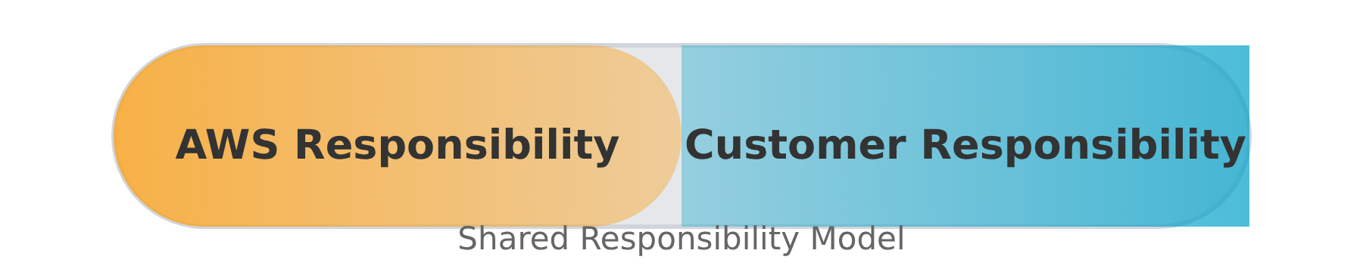
Question 2
Under the AWS Shared Responsibility Model, which of the following tasks is the responsibility of AWS?
A
Encrypting customer data
B
Managing application software
C
Securing the physical data centers
D
Configuring network access controls

Slide 90






Answer 2
The correct answer is C. Securing the physical data centers.
Under the AWS Shared Responsibility Model, AWS is responsible for "security OF the cloud," which includes:
Physical Security
Infrastructure
Physical data centers, regions, availability zones, and edge locations
Host operating systems, virtualization layer, and underlying network infrastructure
While customers are responsible for "security IN the cloud," including:
Encrypting customer data
Managing application software
Configuring network access controls
Key Point: The Shared Responsibility Model divides security responsibilities between AWS (cloud security) and customers (data security).

Slide 91
Stay Connected with Our Cloud Computing Journey!
Dive deeper into the cloud world! Check out our specialized playlists for your continuous learning journey!
Like this video if you found it helpful!
Subscribe for cloud tech updates!
Comment below which cloud topic you want to see next like:
Cloud Security Tips
Cost Optimization Strategies
Multi-Cloud Management
Serverless Computing
Cloud Migration Steps
Anything you'd like 🙂

Slide 92















Steps to Create an AWS Account
A comprehensive guide to get started with Amazon Web Services
Prerequisites
Verification & Plan Selection
Root user email: Valid email for verification
Payment method: Enter billing details
Account name: Descriptive name for your account
Phone verification: Receive and enter PIN
Phone number: For identity verification
Support plan: Select Basic (free) or paid plan
Payment method: Credit card for billing
Activation & Security
Registration Process
Activation: Wait for confirmation email
Sign-up: Enter email and account name
Security: Enable MFA immediately
Password: Create strong password (8+ characters)
Explore: Start using AWS Free Tier
Contact info: Enter details and accept terms

Slide 93
Stay Connected with Our Cloud Computing Journey!
Dive deeper into the cloud world! Check out our specialized playlists for your continuous learning journey!
Like this video if you found it helpful!
Subscribe for cloud tech updates!
Comment below which cloud topic you want to see next like:
Cloud Security Tips
Cost Optimization Strategies
Multi-Cloud Management
Serverless Computing
Cloud Migration Steps
Anything you'd like 🙂

